Slide 1
Accomplishing leadership through possibilities and constraints of materiality in a virtual team meetings
Department of Nordic Studies and Linguistics
Liv Otto Hassert
PhD Student
Maersk Line and Centre for Interaction Research and Communication Design, University of Copenhagen, Denmark
Lise Dahl Arvedsen
PhD Student,
Institute of Organisation,
Copenhagen Business School, Denmark
3rd Interdisciplinary Perspectives on Leadership Symposium
What leaders actually do
10-12 May 2018, Chania, Greece

Slide 2
Outline
Research Question & Key Findings
Literature
Data and method
Data excerpts and findings
Concluding remarks

Slide 3
Key Points
Research Question:
How are the material resources used in the process of ‘doing leadership’ in virtual team meetings?
Key Findings:
Leadership as influence is produced in the mundane, virtual meeting interaction
Control of virtual tools as a necessity and resource to do leadership in virtual situations
Active sharing of control of the virtual tool enables shared leadership

Slide 4
Lines of research informing our study
Leadership studies
Discursive leadership studies
Studies of virtual interaction
Project studies
Studies of virtual teams
Practice studies
Shared/ distributed/ participant leadership
Business meeting studies

Slide 5
Central literature
Larsson & Lundholm, 2010
”leadership, here understood as a process of interpersonal influence towards organizational goals, occurs precisely in the midst of those mundane work activities, constituting management”
Change of focus from ‘inner’ mental conditions to close analysis of talk-in-interaction - everyday routines as vital aspects of processes of leadership
Yulk, 2012
“leadership in organizations is influencing and facilitating individual and collective efforts to accomplish shared objectives”
Leader actions: Task-oriented, relations-oriented, change-oriented, external
DeRue & Ashford, 2010
﻿Leadership "is not something the leader possesses" ... rather, it expresses a recognized relationship among individuals (p. 629)
﻿They propose a conception of leadership identity that invokes all three levels of self construal... a leadership identity comprises three elements: individual internalization, relational recognition, and collective endorsement.
Leader-follower relationships are based on identity work, in which individuals ﻿”claim" an identity and others affirm or "grant" that identity. Following this leadership can be seen as a social construction between two or more actors. (p. 631)

Slide 6
Data
Total hours of observations | 281 hours
Number of meetings | 110 meetings
Number of interviews | 21
Number of companies represented: | 6 Companies
Number of international teams | 24
Nationalities represented in the data:
India
United Kingdom
Finland
Sweden
Norway
Germany
Holland
France
The nation of Brunei
Australia
Spain
Denmark
United States of America
Belgium
Ukraine
Czech republic

Slide 7
Method: Conversation Analysis
Talk as action: CA focus on how talk makes things happen.
CA is now a settled discipline, developed since the pioneering work in the 1960s by the sociologist Harvey Sacks. Inspired by ethnomethodology (Garfinkel)
Analytical focus on social interaction: The moment-by-moment unfolding of actions (Psathas 1995)
Audio and/or video recordings of authentic interaction
Unmotivated looking- inductive approach – phenomena emerge from the data
CA focus on actions and their design, turn taking and sequential positioning, and the implications for participants’ identities and relations (Pomerantz and Fehr 2011).
Years of accumulated findings on the mechanics of talk
Applied to study professional interaction and organizational talk (Antaki 2011; Boden 1994; Heritage & Clayman 2010)
Studies of how professionals interactionally produce e.g. decisions, strategizing, leadership (Clifton 2009, 2014, 2015; Huisman 2001; Larsson & Lundholm 2013; Samra-Fredericks 2003)

Slide 8
Our main RQ: How are the material resources used in the process of ‘doing leadership’ in virtual team meetings?

Slide 9
Data ex 1: International IT Project Team

Slide 10
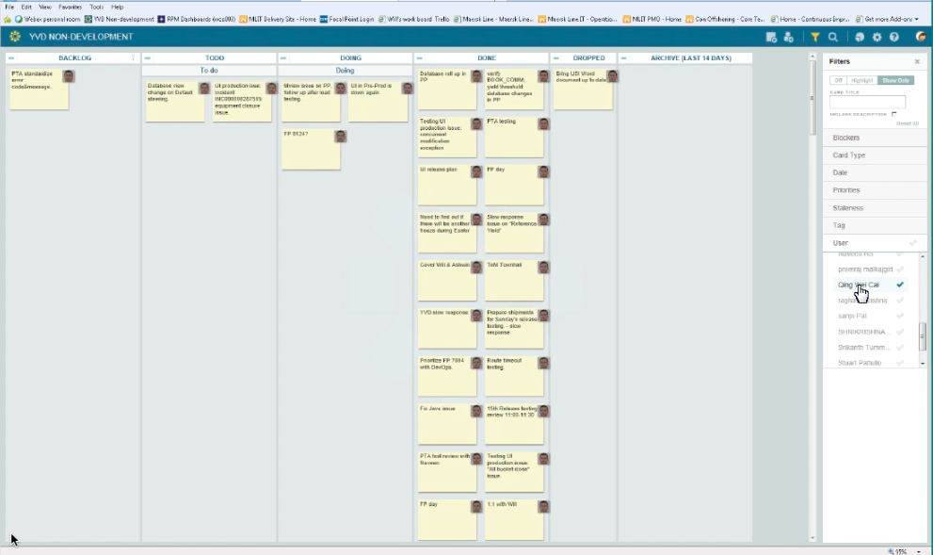
Data ex 1: International IT Project Team
Virtual daily meeting via Webex
Call and screen sharing
Virtual tool: Kanban board
Workflow board which visualizes status of ongoing, completed, and future activities, and task delegation
Participants:
DK: The project manager Adam and one team member
UK: One team member
IN: Team lead Saransh and one vendor team member

Slide 11
Data ex 1: International IT Project Team

Slide 12
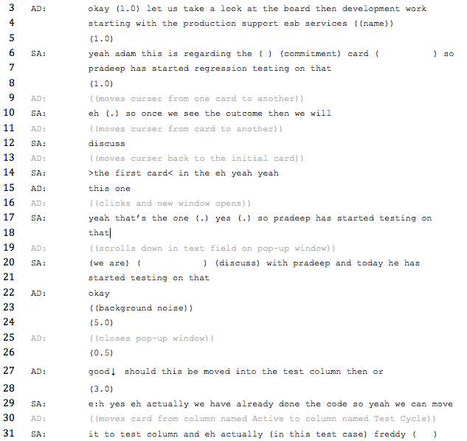
Data ex 1
Findings:
Situational performance of (institutional) roles, e.g. chair and manager
The manager controls the virtual tool
Influence the flow the interaction
Closely coordinated movements and talk
Virtual tool is used to:
Monitor and organize work task – before, in-situ, and onwards
Produce shared understandings
Do leadership

Slide 13
Data ex 2: Global Controlling Team

Slide 14
Data ex 2: Global Controlling Team
Monthly meeting via Skype for Business:
Call, screen sharing and some video.
Purpose of meeting:
Review of budgeting process.
Team member (ANN) has been appointed to facilitate this review, and capture all feedback into a PPT for further future actions.
Participants in this piece of data (9 at the meeting) :
SIM: Team manager, DK, but sits in UK for this meeting
ANN: Team member in FI, facilitating the feedback process
KAT: Team member in DK
ASY: Team member in DE

Slide 15
Data ex 2: Global Controlling Team

Slide 16
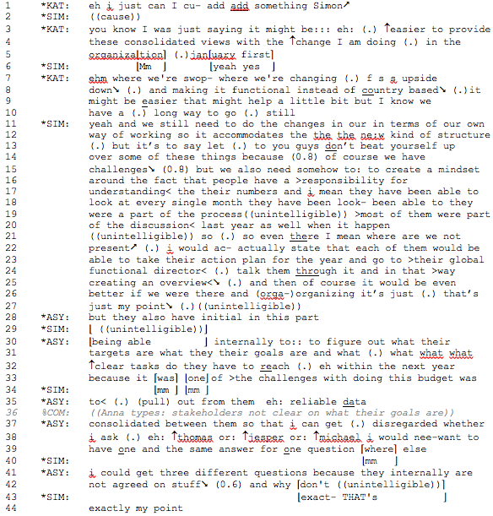
Data ex 2
Findings:
Facilitator of feedback-session (ANN) is in control of the PPT
Situational performance of institutional roles – SIM:
Relations Oriented
BUT additionally shared leadership by ANN:
Task & Change Oriented
Virtual tool is used to:
Produce shared understandings
Claim leadership identity
Do leadership

Slide 17
Concluding remarks
Leadership as influence is produced in the mundane, virtual meeting interaction
Leader roles are shaped by the performance of situational identities with respect to: 1) Actions and 2) chair role/control of virtual tool
Control of virtual tools as a necessity and resource to do leadership in virtual situations: Production of situational leader identities through social interaction and access to the virtual resources
Active sharing of control of the virtual tool enables shared leadership: Virtual tools constraint collective access to leadership processes, but also offer a resource to perform leadership

Slide 18
Thank you!

Slide 19
References
Al-Ani, B., Horspool, a. and Bligh, M. C. (2011) ‘Collaborating with “virtual strangers”: Towards developing a framework for leadership in distributed teams’, Leadership, 7(3), pp. 219–249.
Angouri, J. and Marra, M. (2011) ‘“OK one last thing for today then”: Constructing identities in corporate meeting talk.’, Constructing identities at work., pp. 85–100.
Antaki, C. (2011). Six Kinds of Applied Conversation Analysis. In C. Antaki (Ed.), Applied Conversation Analysis. Intervention and Change in Institutional Talk. London: Palgrave Macmillan.
Asmuss, B. and Svennevig, J. (2009) ‘Meeting Talk: An Introduction’, Journal of Business Communication, 46(1), pp. 3–22. d
Bell, B. S. and Kozlowski, S. W. J. (2002) ‘A Typology of Virtual Teams: Implications for Effective Leadership’, Group & Organization Management, 27(1), pp. 14–49.
Boden, D. (1994) Business of Talk. Wiley.
Bolden, R. and Gosling, J. (2008) ‘Leadership competencies: time to change the tune?’, 2(2), pp. 147–163. Carroll, B. and Levy, L. (2010) ‘Leadership Development as Identity Construction’, Management Communication Quarterly, 24(2), pp. 211–231.
Bolden, R., 2011. Distributed leadership in organizations: A review of theory and research. International Journal of Management Reviews, 13(3), pp.251–269
Carroll, B., Levy, L. and Richmond, D. (2008) ‘Leadership as Practice: Challenging the Competency Paradigm’, Leadership, 4(4), pp. 363–379. Cicmil, S. et al. (2006) ‘Rethinking Project Management: Researching the actuality of projects’, International Journal of Project Management, 24(8), pp. 675–686.
Carson, J.B., Tesluk, P.E. & Marrone, J. a, 2007. Shared leadership in teams: An investigation of antecednt conditions and performance. Academy of Management Journal, 50(5), pp.1217–1234
Cicmil, S. and Hodgson, D. (2006) ‘New possibilities for project management theory: A critical engagement’, Project Management Journal, 38(3), pp. 111–122.
Clifton, J. (2009) ‘Beyond taxonomies of influence: “Doing” influence and making decisions in management team meetings’, Journal of Business Communication, 46(1), pp. 57–79.
Clifton, J. (2014) ‘Small stories, positioning, and the discursive construction of leader identity in business meetings’, Leadership, 10(1), pp. 99–117.
Clifton, J. (2015) ‘Leaders as ventriloquists. Leader identity and influencing the communicative construction of the organisation’, Leadership, 13(3), pp. 1–19.
Connaughton, S., Shuffler, M. & Goodwin, G.F., 2011. Leading distributed teams: The communicative constitution of leadership. Military Psychology, 23(5), pp.502–527.
Crevani, L., Lindgren, M. and Packendorff, J. (2010) ‘Leadership, not leaders: On the study of leadership as practices and interactions’, Scandinavian Journal of Management.
Daim, T. U. et al. (2012) ‘Exploring the communication breakdown in global virtual teams’, International Journal of Project Management, 30(2), pp. 199–212.
Denis, J.-L., Langley, A. and Sergi, V. (2012) ‘Leadership in the Plural’, The Academy of Management Annals, 6(1), pp. 211–283.
Deppermann, A. (2013) ‘Multimodal interaction from a conversation analytic perspective’, Journal of Pragmatics, 46, pp. 1–7.
Fairhurst, G. T. and Connaughton, S. L. (2014) ‘Leadership: A Communicative Perspective’, Leadership, 10(1), pp. 7–35.
Fletcher, J.K., 2004. The paradox of postheroic leadership: An essay on gender, power, and transformational change. Leadership Quarterly, 15(5), pp.647–661.
Garfinkel, H. (1967) Studies in Ethnomethodology. Englewood Cliffs: Prentice-Hall.
Geraldi, J. and Söderlund, J. (2018) ‘Project studies: What it is, where it is going’, International Journal of Project Management. Elsevier Ltd, APM and IPMA, 36(1), pp. 55–70.
Gergen, K.J. & Hersted, L., 2016. Developing leadership as dialogic practice. In J. A. Raelin, ed. Leadership-as-practice: theory and application. Routledge, pp. 178–197.
Graf, E. (2011) ‘“Yes then I will tell you maybe a little bit about the procedure” – Constructing Professional Identity where there is not yet a Profession: The Case of Executive Coaching’, in Marra, M. and Angouri, J. (eds) Constructing Identities at Work. Palgrave Macmillan.
Hassert, L., Nielsen, M. F. and Nielsen, A. M. R. (2016) ‘Møder via video, web eller telefon’, in Kommunikation i Internationale Virksomheder. Forlaget Samfundslitteratur.
Havermans, L., Keegan, A. and Den Hartog, D. (2015) ‘Choosing your words carefully : Leaders ’ narratives of complex emergent problem resolution’, International Journal of Project Management. Elsevier Ltd and International Project Management Association., 33(5), pp. 973–984. Heath, C. and Luff, P. (1992) ‘Media Space and Communicative Asymmetries: Preliminary Observations of Video-Mediated Interaction’, Human-Computer Interaction, 7(3), pp. 315–346..
Heritage, J., & Clayman, S. E. (2010). Talk in Action: Interactions, Identities, and Institutions. Chichester: Wiley-Blackwell.
Hertel, G., Geister, S. and Konradt, U. (2005) ‘Managing virtual teams: A review of current empirical research’, Human Resource Management Review, 15(1), pp. 69–95.
Holmes, J., Schnurr, S. and Marra, M. (2007) ‘Leadership and communication: discursive evidence of a workplace culture change’, Discourse & Communication, 1(4), pp. 433–451.

Slide 20
References
Housley, W. (2000) ‘Category work and knowledgeability within multidisciplinary team meetings’, Text - Interdisciplinary Journal for the Study of Discourse, 20(1), pp. 83–107.
Hällgren, M. and Söderholm, A. (2010) ‘Orchestrating deviations in global projects: Projects-as-practice observations’, Scandinavian Journal of Management, 26(4), pp. 352–367.
Jacobsson, M., Lundin, R. and Söderholm, A. (2015) ‘Researching Projects and Theorizing Families of Temporary Organizations’, Project Management Jounal, 46(5).
Kimble, C. (2011) ‘Building effective virtual teams: How to overcome the problems of trust and identity in virtual teams’, Global Business and Organizational Excellence, 30(2), pp. 6–15.
Larsson, M. and Lundholm, S. E. (2010) ‘Leadership as Work-embedded Influence: A Micro-discursive Analysis of an Everyday Interaction in a Bank’, Leadership, 6(2), pp. 159–184.
Larsson, M. and Lundholm, S. E. (2013) ‘Talking work in a bank: A study of organizing properties of leadership in work interactions’, Human Relations, 66(8). d
Llewellyn, N. and Hindmarsh, J. (2010) Organisation, Interaction and Practice. Studies of Ethnomethodology and Conversation Analysis. New York: Cambridge University Press.
Lundin, R. a. and Söderholm, A. (1995) ‘A theory of the temporary organization’, Scandinavian Journal of Management, 11(4), pp. 437–455.
Meindi Sanford, B.; Dukerich, Janet M., J. R. . E. (1985) ‘The romance of leadership’, Administrative Science Quaterly, 30.
Van De Mieroop, D. and Schnurr, S. (2014) ‘Negotiating meaning and co-constructing institutionalisable answers: Leadership through gate-keeping in performance appraisal interviews’, Journal of Pragmatics, 67, pp. 1–16..
Nicolini, D. (2009) ‘Zooming in and out : studying practices by switching theoretical lenses and trailing connections’.
Nielsen, M. F. (2009) ‘Interpretative Management in Business Meetings: Understanding Managers’ Interactional Strategies through Conversation Analysis’, Journal of Business Communication, 46(1), pp. 23–56. d
Nielsen, M. F. (2013) ‘Interactional challenges in ICT mediated business meeting interaction. Technologies and Techniques.’, in International Institute for Ethnomethodology and Conversation Analysis Conference (IIEMCA).
Panteli, N., 2004. Discursive articulations of presence in virtual organizing. Information and Organization, 14(1), pp.59–81.
Panteli, N. & Chiasson, M., 2008. Exploring Virtuality within and beyond organizations 1st ed., Palgrave Macmillan.
Parry, K.W. & Bryman, A., 2006. Leadership in Organizations. In S. R. Clegg et al., eds. The SAGE Handbook of Organization Studies. SAGE Publications, pp. 447–468.
Pearce, C. L., Conger, J. A. and Locke, E. A. (2008) ‘Shared leadership theory’, Leadership Quarterly, 19(5), pp. 622–628.
Pearce, C. L., Manz, C. C. and Sims, H. P. (2009) ‘Where Do We Go From Here?:. Is Shared Leadership the Key to Team Success?’, Organizational Dynamics, 38(3), pp. 234–238.
Powell Gabriele; Ives, Blake, A. P. (2004) ‘Virtual Teams: A Review of Current Literature and Directions for Future Research’, The Data Base for Advances in Information Systems, 35(1).
Psathas, G. (1995). Conversation Analysis: The Study of Talk-in-Interaction. Thousand Oaks: SAGE Publications.
Raelin, J. A. (2007) ‘Toward an Epistemology of Practice’, Academy of Management Learning & Education, 6(4), pp. 495–519.
Sacks, H. (1995) Lectures on Conversation. Edited by Gail Jefferson. Oxford: Blackwell Publishing.
Sahlin-Andersson, K. and Söderholm, A. (2002) ‘The Scandinavian School of Project Studies’, in Sahlin-Andersson, K. and Söderholm, A. (eds) Beyond project management. New perspectives on the temporary permanent dilemma. Malmo: Copenhagen Business School Press.
Schatzki, T. R., Knorr, C. K. and von Savigny, E. (2001) The practice turn in contemporary theory. London: Routledge.
Schegloff, E. A. (1986) ‘The Routine as Achievement’, Human Studies, 9(2–3), pp. 111–151.
Schnurr, S. and Zayts, O. (2011) ‘Be(com) ing a Leader : A Case Study’, in Angouri, J. and Marra, M. (eds) Constructing Identities at Work. Palgrave Macmillan, pp. 40–60.
Whittle, a. et al. (2014) ‘Category predication work, discursive leadership and strategic sensemaking’, Human Relations, 68(3), pp. 377–407.
Yukl, G. (2012) ‘Effective Leadership Behavior: What We Know and’, Academy of Management Perspectives, 26(November), pp. 66–85.

